Slide 1
Design and Analysis of Computer Algorithm
Lecture 1
Assoc. Prof.Pradondet Nilagupta
Department of Computer Engineering
pom@ku.ac.th

Slide 2
Acknowledgement
This lecture note has been summarized from lecture note on Data Structure and Algorithm, Design and Analysis of Computer Algorithm all over the world. I can’t remember where those slide come from. However, I’d like to thank all professors who create such a good work on those lecture notes. Without those lectures, this slide can’t be finished.
Design and Analysis of Computer Algorithm

Slide 3
Course Information
Course webpage
http://www.cpe.ku.ac.th/~pom/courses/204512/204512.html
Office hours
  Wed 5:00-6:00PM or make an appointment
Grading policy
  Assign. 20%, Midterm: 40%, Final: 40%
Design and Analysis of Computer Algorithm

Slide 4
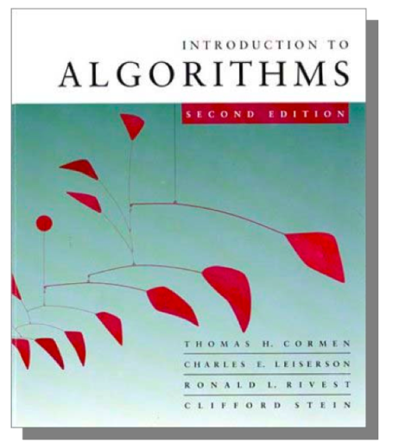
More Information
Textbook
  Introduction to Algorithms 2nd ,Cormen,
  Leiserson, Rivest and Stein, The MIT Press, 2001.
Others
  Introduction to Design & Analysis Computer Algorithm 3rd, Sara Baase, Allen Van Gelder, Adison-Wesley, 2000.
  Algorithms, Richard Johnsonbaugh, Marcus Schaefer, Prentice Hall, 2004.
  Introduction to The Design and Analysis of Algorithms 2nd Edition, Anany Levitin, Adison-Wesley, 2007.
Design and Analysis of Computer Algorithm

Slide 5
Course Objectives
This course introduces students to the analysis and design of computer algorithms. Upon completion of this course, students will be able to do the following:
  Analyze the asymptotic performance of algorithms.
  Demonstrate a familiarity with major algorithms and data structures.
  Apply important algorithmic design paradigms and methods of analysis.
  Synthesize efficient algorithms in common engineering design situations.
Design and Analysis of Computer Algorithm

Slide 6
What is Algorithm?
Algorithm
  is any well-defined computational procedure that takes some value, or set of values, as input and produces some value, or set of values, as output.
  is thus a sequence of computational steps that transform the input into the output.
  is a tool for solving a well - specified computational problem.
  Any special method of solving a certain kind of problem (Webster Dictionary)
Design and Analysis of Computer Algorithm

Slide 7

What is a program?
A program is the expression of an algorithm in a programming language
a set of instructions which the computer will follow to solve a problem
Design and Analysis of Computer Algorithm

Slide 8
Where We're Going (1/2)
Learn general approaches to algorithm design
  Divide and conquer
  Greedy method
  Dynamic Programming
  Basic Search and Traversal Technique
  Graph Theory
  Linear Programming
  Approximation Algorithm
  NP Problem
Design and Analysis of Computer Algorithm

Slide 9
Where We're Going(2/2)
Examine methods of analyzing algorithm correctness and efficiency
  Recursion equations
  Lower bound techniques
  O,Omega and Theta notations for best/worst/average case analysis
Decide whether some problems have no solution in reasonable time
  List all permutations of n objects (takes n! steps)
  Travelling salesman problem
Investigate memory usage as a different measure of efficiency
Design and Analysis of Computer Algorithm

Slide 10
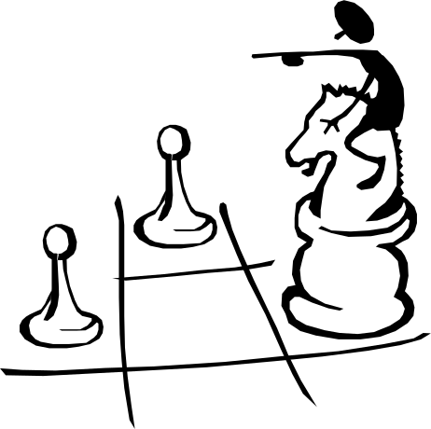
Some Application
Study problems these techniques can be applied to
  sorting
  data retrieval
  network routing
  Games
  etc
Design and Analysis of Computer Algorithm

Slide 11
The study of Algorithm
How to devise algorithms
How to express algorithms
How to validate algorithms
How to analyze algorithms
How to test a program
Design and Analysis of Computer Algorithm

Slide 12
Importance of Analyze Algorithm
Need to recognize limitations of various algorithms for solving a problem
Need to understand relationship between problem size and running time
  When is a running program not good enough?
Need to learn how to analyze an algorithm's running time without coding it
Need to learn techniques for writing more efficient code
Need to recognize bottlenecks in code as well as which parts of code are easiest to optimize
Design and Analysis of Computer Algorithm

Slide 13

Why do we analyze about them?
understand their behavior, and (Job -- Selection, performance, modify)
improve them. (Research)
Design and Analysis of Computer Algorithm

Slide 14
What do we analyze about them?
Correctness
  Does the input/output relation match algorithm requirement?
Amount of work done (aka complexity)
  Basic operations to do task
Amount of space used
  Memory used
Design and Analysis of Computer Algorithm

Slide 15

What do we analyze about them?
Simplicity, clarity
  Verification and implementation.
Optimality
  Is it impossible to do better?
Design and Analysis of Computer Algorithm

Slide 16

Complexity
The complexity of an algorithm is simply the amount of work the algorithm performs to complete its task.
Design and Analysis of Computer Algorithm

Slide 17

RAM model
has one processor
executes one instruction at a time
each instruction takes "unit time“
has fixed-size operands, and
has fixed size storage (RAM and disk).
Design and Analysis of Computer Algorithm

Slide 18
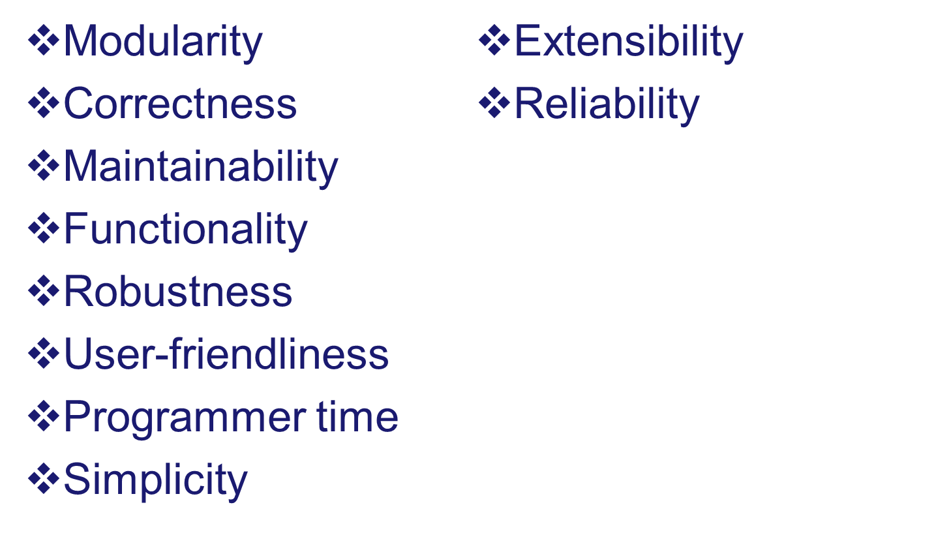
What’s more important than performance?
Design and Analysis of Computer Algorithm

Slide 19
Why study algorithms and performance?
Algorithms help us to understand scalability.
Performance often draws the line between what is feasible and what is impossible.
Algorithmic mathematics provides a language for talking about program behavior.
Performance is the currency of computing.
The lessons of program performance generalize to other computing resources.
Speed is fun!
Design and Analysis of Computer Algorithm

Slide 20
Example Of Algorithm

Slide 21
What is the running time of this algorithm?
PUZZLE(x)
while x != 1
if x is even
then x = x / 2
else x = 3x + 1
Sample run: 7, 22, 11, 34, 17, 52, 26, 13, 40, 20, 10, 5, 16, 8, 4, 2, 1
Design and Analysis of Computer Algorithm
pp <number>

Slide 22

The Selection Problem (1/2)
Problem: given a group of n numbers, determine the k^{th} largest
Algorithm 1
  Store numbers in an array
  Sort the array in descending order
  Return the number in position k
Design and Analysis of Computer Algorithm

Slide 23

The Selection Problem(2/2)
Algorithm 2
  Store first k numbers in an array
  Sort the array in descending order
  For each remaining number, if the number is larger than the k^{th} number, insert the number in the correct position of the array
  Return the number in position k
Which algorithm is better?
Design and Analysis of Computer Algorithm

Slide 24
Example: What is an Algorithm?
Problem: Input is a sequence of integers stored in an array.
Output the minimum.
INPUT
Algorithm
OUTPUT
instance
m:= a[1];
for I:=2 to size of input
if m > a[I] then m:=a[I];
return s
25, 90, 53, 23, 11, 34
11
m
Data-Structure
Design and Analysis of Computer Algorithm

Slide 25
Define Problem
Problem:
  Description of Input-Output relationship
Algorithm:
  A sequence of computational step that transform the input into the output.
Data Structure:
  An organized method of storing and retrieving data.
Our task:
  Given a problem, design a correct and good algorithm that solves it.
Design and Analysis of Computer Algorithm

Slide 26
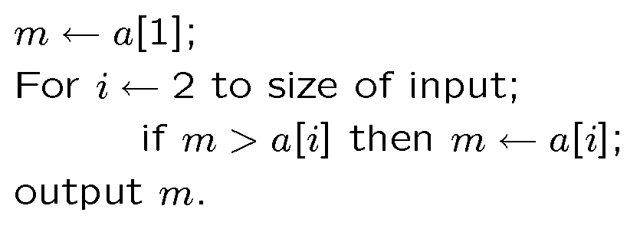
Example Algorithm A
Problem: The input is a sequence of integers stored in array.
Output the minimum.
Algorithm A
Design and Analysis of Computer Algorithm

Slide 27
Example Algorithm B
This algorithm uses two temporary arrays.
copy the input a to array t1;
assign n ← size of input;
While n > 1
For i ← 1 to n /2
t2[ i ] ← min (t1 [ 2*i ], t1[ 2*i + 1] );
copy array t2 to t1;
n ←n/2;
3. Output t2[1];
Design and Analysis of Computer Algorithm

Slide 28
Visualize Algorithm B
34
6
5
9
20
8
11
7
Loop 1
6
5
8
7
Loop 2
5
7
Loop 3
5
Design and Analysis of Computer Algorithm

Slide 29
Example Algorithm C
Sort the input in increasing order. Return the
first element of the sorted data.
34
6
5
9
20
8
11
7
black
box
Sorting
5
6
7
8
9
11
20
34
Design and Analysis of Computer Algorithm

Slide 30
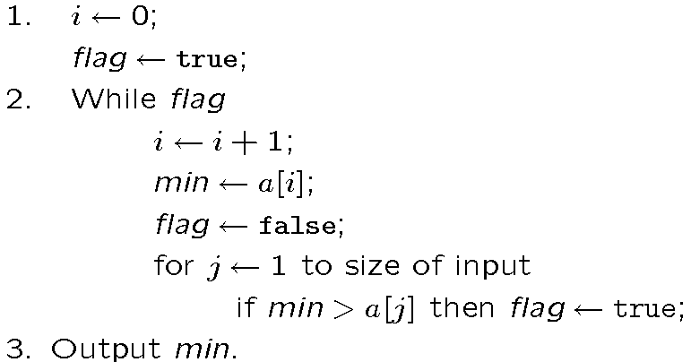
Example Algorithm D
For each element, test whether it is the minimum.
Design and Analysis of Computer Algorithm

Slide 31
Which algorithm is better?
The algorithms are correct, but which is the best?
Measure the running time (number of operations needed).
Measure the amount of memory used.
Note that the running time of the algorithms increase as the size of the input increases.
Design and Analysis of Computer Algorithm

Slide 32
What do we need?
Correctness: Whether the algorithm computes
the correct solution for all instances
Efficiency: Resources needed by the algorithm
1. Time: Number of steps.
2. Space: amount of memory used.
Measurement “model”: Worst case, Average case
and Best case.
Design and Analysis of Computer Algorithm

Slide 33
Time vs. Size of Input
Measurement parameterized by the size of the input.
The algorihtms A,B,C are implemented and run in a PC.
Algorithms D is implemented and run in a supercomputer.
Let T_{k}( n ) be the amount of time taken by the Algorithm
4
T_{d}(n)
T_{c} (n)
Running time
(second)
T_{b} (n)
2
T_{a} (n)
0
500
1000
Input Size
Design and Analysis of Computer Algorithm

Slide 34
Methods of Proof
Proof by Contradiction
  Assume a theorem is false; show that this assumption implies a property known to be true is false -- therefore original hypothesis must be true
Proof by Counterexample
  Use a concrete example to show an inequality cannot hold
Mathematical Induction
  Prove a trivial base case, assume true for k, then show hypothesis is true for k+1
  Used to prove recursive algorithms
Design and Analysis of Computer Algorithm

Slide 35
Review: Induction
Suppose
  S(k) is true for fixed constant k
    Often k = 0
  S(n) → S(n+1) for all n >= k
Then S(n) is true for all n >= k
Design and Analysis of Computer Algorithm

Slide 36
Proof By Induction
Claim:S(n) is true for all n >= k
Basis:
  Show formula is true when n = k
Inductive hypothesis:
  Assume formula is true for an arbitrary n
Step:
  Show that formula is then true for n+1
Design and Analysis of Computer Algorithm

Slide 37
Induction Example:
Gaussian Closed Form
Prove 1 + 2 + 3 + … + n = n(n+1) / 2
  Basis:
    If n = 0, then 0 = 0(0+1) / 2
  Inductive hypothesis:
    Assume 1 + 2 + 3 + … + n = n(n+1) / 2
  Step (show true for n+1):
    1 + 2 + … + n + n+1 = (1 + 2 + …+ n) + (n+1)
    = n(n+1)/2 + n+1 = [n(n+1) + 2(n+1)]/2
    = (n+1)(n+2)/2 = (n+1)(n+1 + 1) / 2
Design and Analysis of Computer Algorithm

Slide 38
Induction Example:
Geometric Closed Form
Prove a⁰ + a¹ + … + a^{n} = (a^{n+1} - 1)/(a - 1) for all a ≠ 1
  Basis: show that a⁰ = (a⁰⁺¹ - 1)/(a - 1)
    a⁰ = 1 = (a¹ - 1)/(a - 1)
  Inductive hypothesis:
    Assume a⁰ + a¹ + … + a^{n} = (a^{n+1} - 1)/(a - 1)
  Step (show true for n+1):
    a⁰ + a¹ + … + a^{n+1} = a⁰ + a¹ + … + a^{n} + a^{n+1}
    = (a^{n+1} - 1)/(a - 1) + a^{n+1} = (a^{n+1+1} - 1)/(a - 1)
Design and Analysis of Computer Algorithm

Slide 39
Induction
We’ve been using weak induction
Strong induction also holds
  Basis: show S(0)
  Hypothesis: assume S(k) holds for arbitrary k <= n
  Step: Show S(n+1) follows
Another variation:
  Basis: show S(0), S(1)
  Hypothesis: assume S(n) and S(n+1) are true
  Step: show S(n+2) follows
Design and Analysis of Computer Algorithm

Slide 40

Basic Recursion
Base case: value for which function can be evaluated without recursion
Two fundamental rules
  Must always have a base case
  Each recursive call must be to a case that eventually leads toward a base case
Design and Analysis of Computer Algorithm

Slide 41
Bad Example of Recursion
Example of non-terminating recursive program (let n=1)
int bad(unsigned int n)
{
if(n == 0)
return 0;
else
return(bad(n/3 + 1) + n - 1);
}
Design and Analysis of Computer Algorithm

Slide 42
Recursion(1/2)
Problem: write an algorithm that will strip digits from an integer and print them out one by one
void print_out(int n)
{
if(n < 10)
print_digit(n); /*outputs single-digit to terminal*/
else {
print_out(n/10); /*print the quotient*/
print_digit(n%10); /*print the remainder*/
}
}
Design and Analysis of Computer Algorithm

Slide 43
Recursion(2/2)
Prove by induction that the recursive printing program works:
  basis: If n has one digit, then program is correct
  hypothesis: Print_out works for all numbers of k or fewer digits
  case k+1: k+1 digits can be written as the first k digits followed by the least significant digit
The number expressed by the first k digits is exactly floor( n/10 )? which by hypothesis prints correctly; the last digit is n%10; so the (k+1)-digit is printed correctly
By induction, all numbers are correctly printed
Design and Analysis of Computer Algorithm

Slide 44
Recursion
Don't need to know how recursion is being managed
Recursion is expensive in terms of space requirement; avoid recursion if simple loop will do
Last two rules
  Assume all recursive calls work
  Do not duplicate work by solving identical problem in separated recursive calls
Evaluate fib(4) -- use a recursion tree
fib(n) = fib(n-1) + fib(n-2)
Design and Analysis of Computer Algorithm

Slide 45
What is Algorithm Analysis?
How to estimate the time required for an algorithm
Techniques that drastically reduce the running time of an algorithm
A mathemactical framwork that more rigorously describes the running time of an algorithm
Design and Analysis of Computer Algorithm
pp <number>

Slide 46
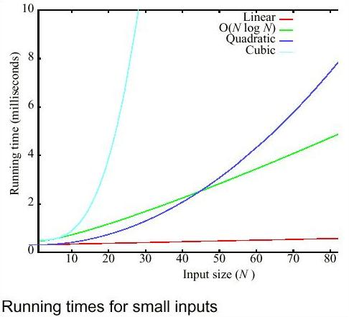
Running time for small inputs
Design and Analysis of Computer Algorithm
pp <number>

Slide 47
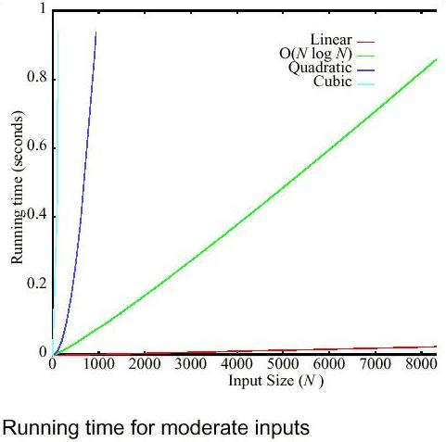
Running time for moderate inputs
Design and Analysis of Computer Algorithm

Slide 48
Important Question
Is it always important to be on the most preferred curve?
How much better is one curve than another?
How do we decide which curve a particular algorithm lies on?
How do we design algorithms that avoid being on the bad curves?
Design and Analysis of Computer Algorithm

Slide 49
Algorithm Analysis(1/5)
Measures the efficiency of an algorithm or its implementation as a program as the input size becomes very large
We evaluate a new algorithm by comparing its performance with that of previous approaches
  Comparisons are asymtotic analyses of classes of algorithms
We usually analyze the time required for an algorithm and the space required for a datastructure
Design and Analysis of Computer Algorithm

Slide 50
Algorithm Analysis (2/5)
Many criteria affect the running time of an algorithm, including
  speed of CPU, bus and peripheral hardware
  design think time, programming time and debugging time
  language used and coding efficiency of the programmer
  quality of input (good, bad or average)
Design and Analysis of Computer Algorithm

Slide 51
Algorithm Analysis (3/5)
Programs derived from two algorithms for solving the same problem should both be
  Machine independent
  Language independent
  Environment independent (load on the system,...)
  Amenable to mathematical study
  Realistic
Design and Analysis of Computer Algorithm

Slide 52
Algorithm Analysis (4/5)
In lieu of some standard benchmark conditions under which two programs can be run, we estimate the algorithm's performance based on the number of key and basic operations it requires to process an input of a given size
For a given input size n we express the time T to run the algorithm as a function T(n)
Concept of growth rate allows us to compare running time of two algorithms without writing two programs and running them on the same computer
Design and Analysis of Computer Algorithm

Slide 53
Algorithm Analysis (5/5)
Formally, let T(A,L,M) be total run time for algorithm A if it were implemented with language L on machine M. Then the complexity class of algorithm A is
  O(T(A,L1,M1) U O(T(A,L2,M2)) U O(T(A,L3,M3)) U ...
Call the complexity class V; then the complexity of A is said to be f if V = O(f)
The class of algorithms to which A belongs is said to be of at most linear/quadratic/ etc. growth in best case if the function T_{A} best(n) is such (the same also for average and worst case).
Design and Analysis of Computer Algorithm

Slide 54
Asymptotic Performance
In this course, we care most about asymptotic performance
  How does the algorithm behave as the problem size gets very large?
    Running time
    Memory/storage requirements
    Bandwidth/power requirements/logic gates/etc.
Design and Analysis of Computer Algorithm

Slide 55
Asymptotic Notation
By now you should have an intuitive feel for asymptotic (big-O) notation:
  What does O(n) running time mean? O(n²)?
  O(n lg n)?
  How does asymptotic running time relate to asymptotic memory usage?
Our first task is to define this notation more formally and completely
Design and Analysis of Computer Algorithm

Slide 56
Analysis of Algorithms
Analysis is performed with respect to a computational model
We will usually use a generic uniprocessor random-access machine (RAM)
  All memory equally expensive to access
  No concurrent operations
  All reasonable instructions take unit time
    Except, of course, function calls
  Constant word size
    Unless we are explicitly manipulating bits
Design and Analysis of Computer Algorithm

Slide 57
Input Size
Time and space complexity
  This is generally a function of the input size
    E.g., sorting, multiplication
  How we characterize input size depends:
    Sorting: number of input items
    Multiplication: total number of bits
    Graph algorithms: number of nodes & edges
    Etc
Design and Analysis of Computer Algorithm

Slide 58
Running Time
Number of primitive steps that are executed
  Except for time of executing a function call most statements roughly require the same amount of time
    y = m * x + b
    c = 5 / 9 * (t - 32 )
    z = f(x) + g(y)
We can be more exact if need be
Design and Analysis of Computer Algorithm

Slide 59
Analysis
Worst case
  Provides an upper bound on running time
  An absolute guarantee
Average case
  Provides the expected running time
  Very useful, but treat with care: what is “average”?
    Random (equally likely) inputs
    Real-life inputs
Design and Analysis of Computer Algorithm

Slide 60
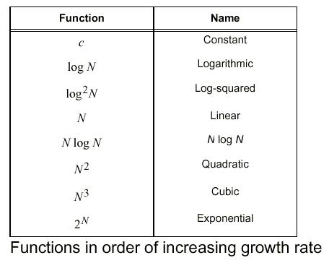
Function of Growth rate
Design and Analysis of Computer Algorithm

